Slide 1
Course Code:CSC402A Course Title: Web Architecture and Application Development
Course Leader:
Kishore S.M.
kishore.cs.et@msruas.ac.in

Slide 2
Objectives
At the end of the lecture, students will be able to
Describe fundamentals of HTTP
Describe about Web Servers

Slide 3
Contents
HTTP
Web Servers

Slide 4
HTTP
There were three basic components devised by Tim Berners-Lee comprising the essence of Web technology:
A markup language for formatting hypertext documents.
A uniform notation scheme for addressing accessible resources over the network.
A protocol for transporting messages over the network.
Fundamentals of HTTP
HTTP is the foundation protocol of the World Wide Web
HTTP is an application level protocol in the TCP/IP protocol suite, using TCP as the underlying Transport Layer protocol for transmitting messages

Slide 5
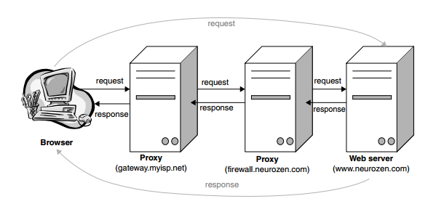
HTTP
Request/response Paradigm

Slide 6
HTTP
Request/response Paradigm
Browsers (and possibly proxy servers as well) send messages to HTTP servers
These servers generate messages that are sent back to the browsers
The messages sent to HTTP servers are called requests
The messages generated by the servers are called responses
In practice, servers and browsers rarely communicate directly—there are one or more proxies in between. A connection is defined as a virtual circuit that is composed of HTTP agents, including the browser, the server, and intermediate proxies participating in the exchange

Slide 7
HTTP
Stateless Protocol
When a protocol supports ‘state’, this means that it provides for the interaction between client and server to contain a sequence of commands Ex: FTP, SMTP and POP. The server is required to maintain the ‘state’ of the connection throughout the transmission of successive commands, until the connection is terminated.
In contrast, HTTP is said to be ‘stateless’. Defining HTTP as a stateless protocol made things simpler, but it also imposed limitations on the capabilities of Web applications.
By definition, the lifetime of a connection was a single request/response exchange. This meant that there was no way to maintain persistent information about a ‘session’ of successive interactions between a client and server.

Slide 8
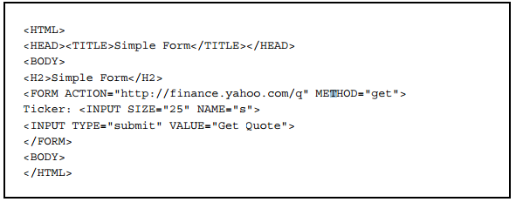
HTTP
Request methods in HTTP
GET - The simplest of the request methods is GET
A GET request does not have a body

Slide 9
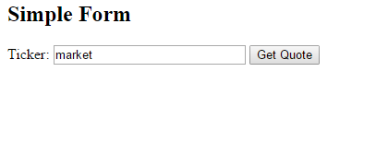
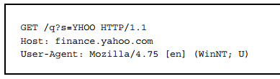
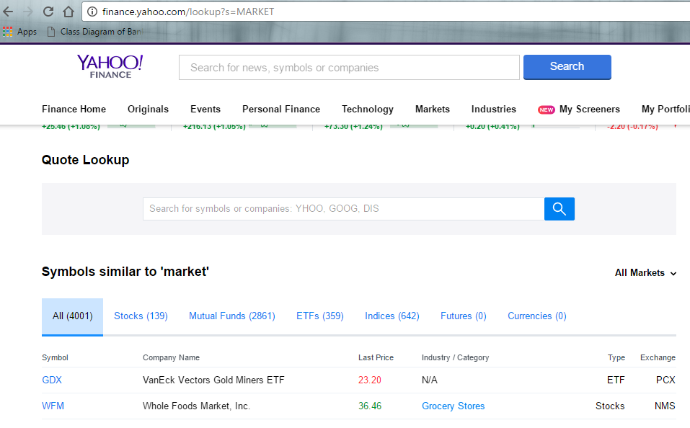
HTTP
The URL constructed by the browser is
http://finance.yahoo.com/lookup?s=MARKET

Slide 10
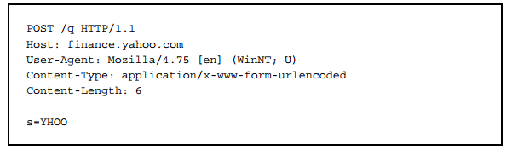
HTTP
POST
A fundamental difference between GET and POST requests is that POST requests have a body
Note that the URL constructed by the browser does not contain the form parameters in the query string
Instead, these parameters are included after the headers as part of the message body

Slide 11
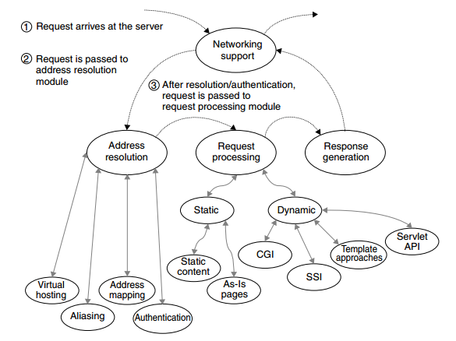
Web Servers
Web servers enable HTTP access to a ‘Web site,’ which is simply a collection of documents and other information organized into a tree structure, much like a computer’s file system.
Basic Operation

Slide 12
Web Servers
Virtual Hosting: if this Web server is providing service for multiple domains, determine the domain for which this request is targeted, and use the detected domain to select configuration parameters.
Address Mapping: determine whether this is a request for static or dynamic content, based on the URL path and selected server configuration parameters, and resolve the address into an actual location within the server’s file system.
Authentication: if the requested resource is protected, examine authorization credentials to see if the request is coming from an authorized user.

Slide 13
Web Servers
Delivery of static content
Web servers present both static content and dynamic content. Static content falls into two categories:
static content pages: static files containing HTML pages, XML pages, plain text, images, etc., for which HTTP responses must be constructed (including headers)
as-is pages: pages for which complete HTTP responses (including headers) already exist and can be presented ‘as is’.
Static content pages
For a static content page, the server maps the URL to a file location relative to the server document root
Example: Website http://mysite.org/pages/school.html

Slide 14
Web Servers
As-is pages
The idea is that such pages contain complete responses and the server is supposed to send them back ‘as-is’ without adding status codes or headers
That means that you can put together a desired response, store it on the server in a file that would be recognized by the server as an ‘as-is’ file
Be guaranteed to receive your unchanged response when the file is requested

Slide 15
Web Servers
Delivery of dynamic content
The original mechanisms for serving up dynamic content are CGI (Common Gateway Interface) and SSI (Server Side Includes).
Today’s Web servers use more sophisticated and more efficient mechanisms for serving up dynamic content, but CGI and SSI date back to the very beginnings of the World Wide Web.
CGI
The CGI mechanism assumes that, when a request to execute a CGI script arrives at the server, a new ‘process’ will be ‘spawned’ to execute a particular application program, supplying that program with a specified set of parameters.

Slide 16
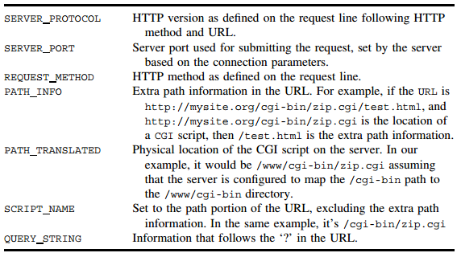
Web Servers
The heart of the CGI specification is the designation of a fixed set of environment variables that all CGI applications know about and have access to
The server is supposed to use request information to populate variables

Slide 17
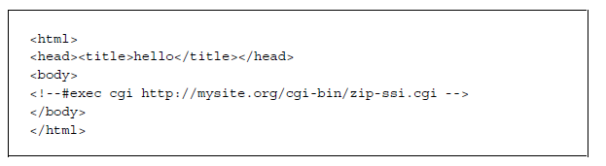
Web Servers
SSI mechanism (Server Side Includes)
SSI provides mechanisms for including auxiliary files (or the results of the execution of CGI scripts) into an HTML page
SSI is not a replacement for CGI, but it is an easy way to add dynamic content to pages without a lot of work
A sample SSI page is shown below:

Slide 18
Web Servers
Advanced Mechanisms for Dynamic Content Delivery
Servlets
A better approach to serving dynamic content is the Servlet API—Java technology for implementing applications that are portable not only across different servers but also across different hardware platforms and operating systems.
The servlet API uses server application modules that remain resident and reusable, rather than requiring the spawning of a new process for every request
The servlet API is portable across servers, operating systems, and hardware platforms
Servlets are Java programs that have access to information in HTTP requests and that generate HTTP responses that are sent back to browsers and proxies

Slide 19
Web Servers
Java Server Pages
The Java Server Pages (JSP) mechanism came about as Sun’s response to Microsoft’s own template processing approach, Active Server Pages
JSP is a technology for developing web pages that support dynamic content which helps developers insert java code in HTML pages by making use of special JSP tags, most of which start with <% and end with %>
Why Use JSP?
Performance is significantly better because JSP allows embedding Dynamic Elements in HTML Pages itself instead of having a separate CGI files

Slide 20
Web Servers
JSP are always compiled before it's processed by the server unlike CGI/Perl which requires the server to load an interpreter and the target script each time the page is requested
Java Server Pages are built on top of the Java Servlets API, so like Servlets, JSP also has access to all the powerful Enterprise Java APIs, including JDBC, JNDI, EJB, JAXP etc
JSP pages can be used in combination with servlets that handle the business logic, the model supported by Java servlet template engines

Slide 21
Web Servers
Advantages of JSP
vs. Active Server Pages (ASP): The advantages of JSP are twofold. First, the dynamic part is written in Java, not Visual Basic or other MS specific language, so it is more powerful and easier to use. Second, it is portable to other operating systems and non-Microsoft Web servers
vs. Pure Servlets: It is more convenient to write (and to modify!) regular HTML than to have plenty of println statements that generate the HTML
vs. Server-Side Includes (SSI): SSI is really only intended for simple inclusions, not for "real" programs that use form data, make database connections, and the like

Slide 22
Web Servers
vs. JavaScript: JavaScript can generate HTML dynamically on the client but can hardly interact with the web server to perform complex tasks like database access and image processing etc.
vs. Static HTML: Regular HTML, of course, cannot contain dynamic information.

Slide 23
Web Servers
Server Security
The obvious precaution is to minimize remote login access to the server machine— up to disabling it completely
If this is too drastic a precaution for what you need, at least make sure that all attempts to access the system are monitored and logged, and all passwords are crack-resilient
Do not provide both FTP and HTTP access to the same files
The problem is that you can spend as much effort as you want securing your HTTP server but it will not help if it is possible to establish an anonymous FTP connection to the host machine and post an executable in a CGI directory

Slide 24
Web Servers
Secure HTTP
Even if the server is safe, HTTP messages containing sensitive information are still vulnerable
The most obvious solution for guarding this information is, of course, encryption
HTTPS is the secure version of the HTTP protocol. All HTTPS messages are the same except that they are transmitted over a Secure Socket Layer
Secure Socket Layer (SSL) connection—messages are encrypted before the transmission and decrypted after being received by the server

Slide 25
Web Servers
The SSL protocol supports the use of a variety of different cryptographic algorithms to authenticate the server and the browser to each other, transmit certificates, and establish session encryption keys
Firewalls and Proxies
There exist many different firewall configurations that fall into two major categories: dual-homed gateways and screened-host gateways
Dual-homed firewall - is a computer with two different interface cards, one of which is connected to the LAN and one to the outside world
Screened-host - gateways are network routers that have the responsibility of filtering traffic between the LAN and the outside world

Slide 26
Web Servers
To provide security do not run full-fledged HTTP server on the firewall machine but to replace it with an HTTP proxy that may be configured to screen HTTP requests and forward them to proper internal hosts.’
Different proxy configurations may be selected depending on a wide range of circumstances but what is important is that no processing is performed on the firewall host and the internal machines are not exposed directly to the outside world

Slide 27
Summary
HTTP is the foundation protocol of the World Wide Web
The Java Server Pages (JSP) mechanism came about as Sun’s response to Microsoft’s own template processing approach, Active Server Pages
A better approach to serving dynamic content is the Servlet API

